Slide 1
Project Tamob Detection model
By Jonathan Ngien

Slide 2
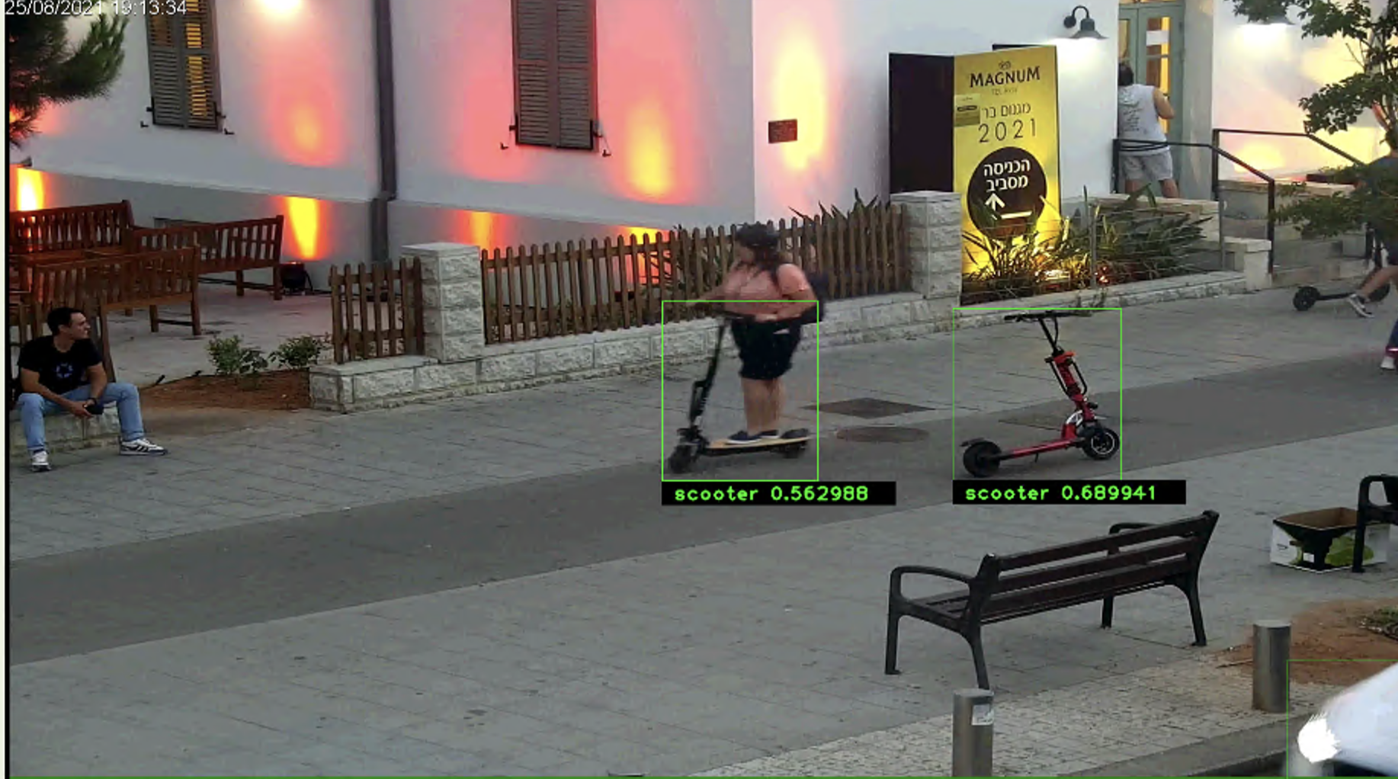
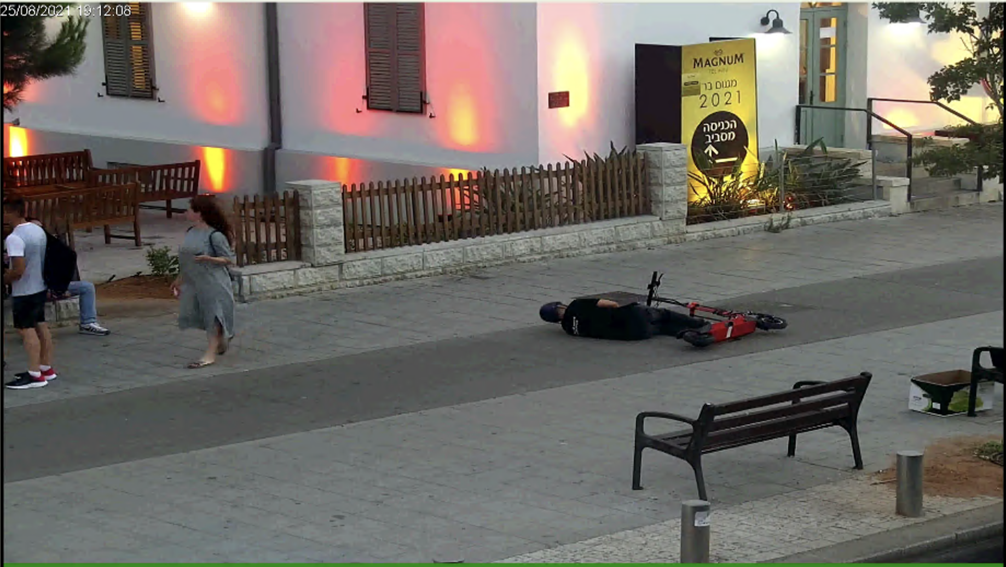
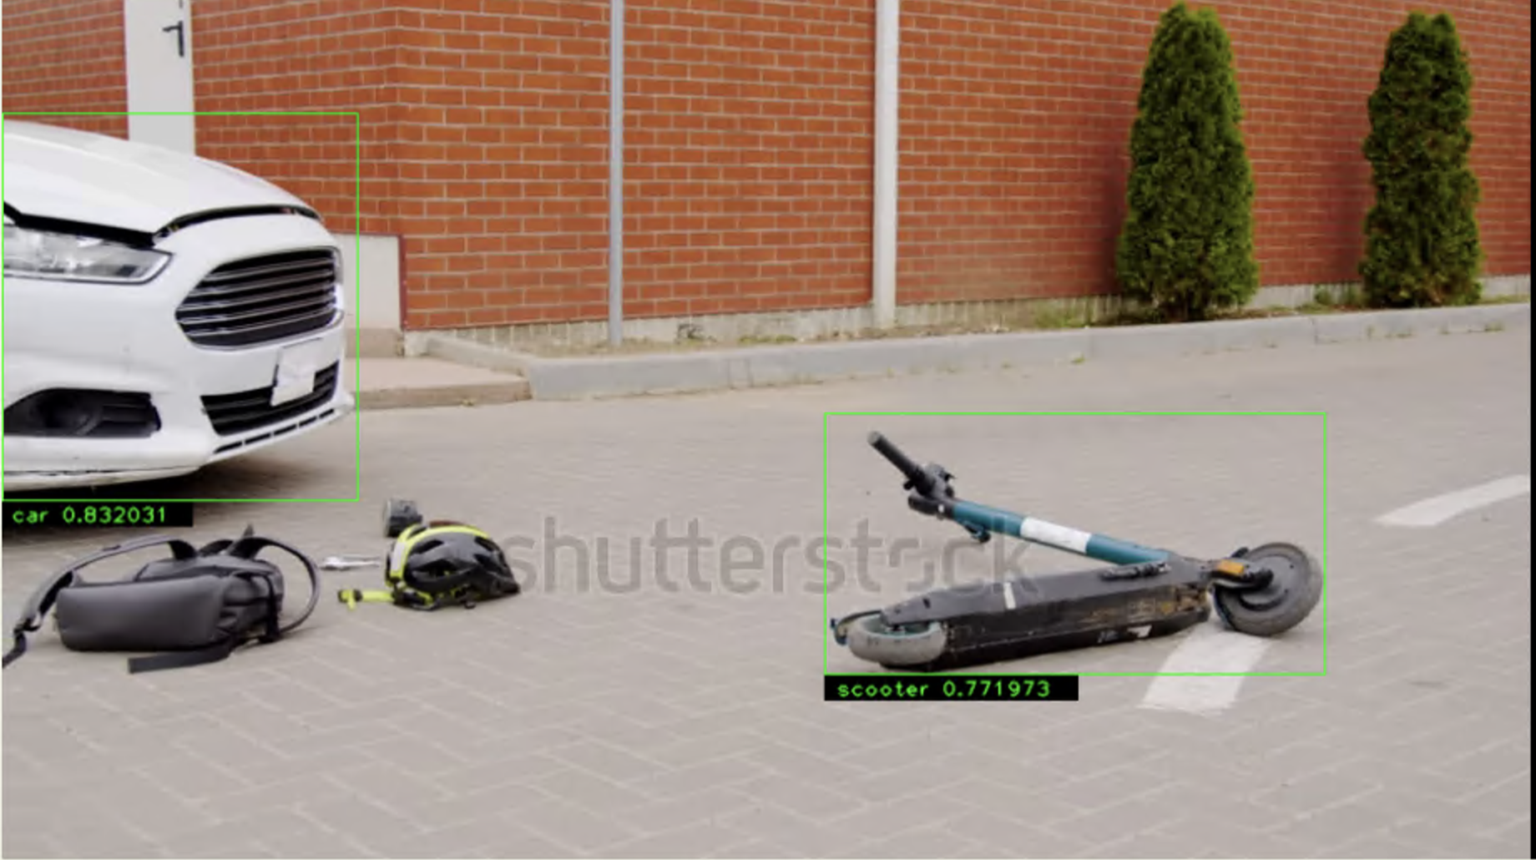
PMD Detection – Abandoned Scooter
Can detect standing / fallen scooters without humans well
- However, when a human is close to the scooter, it may not detect the scooter
Can detect falling scooters well

Slide 3
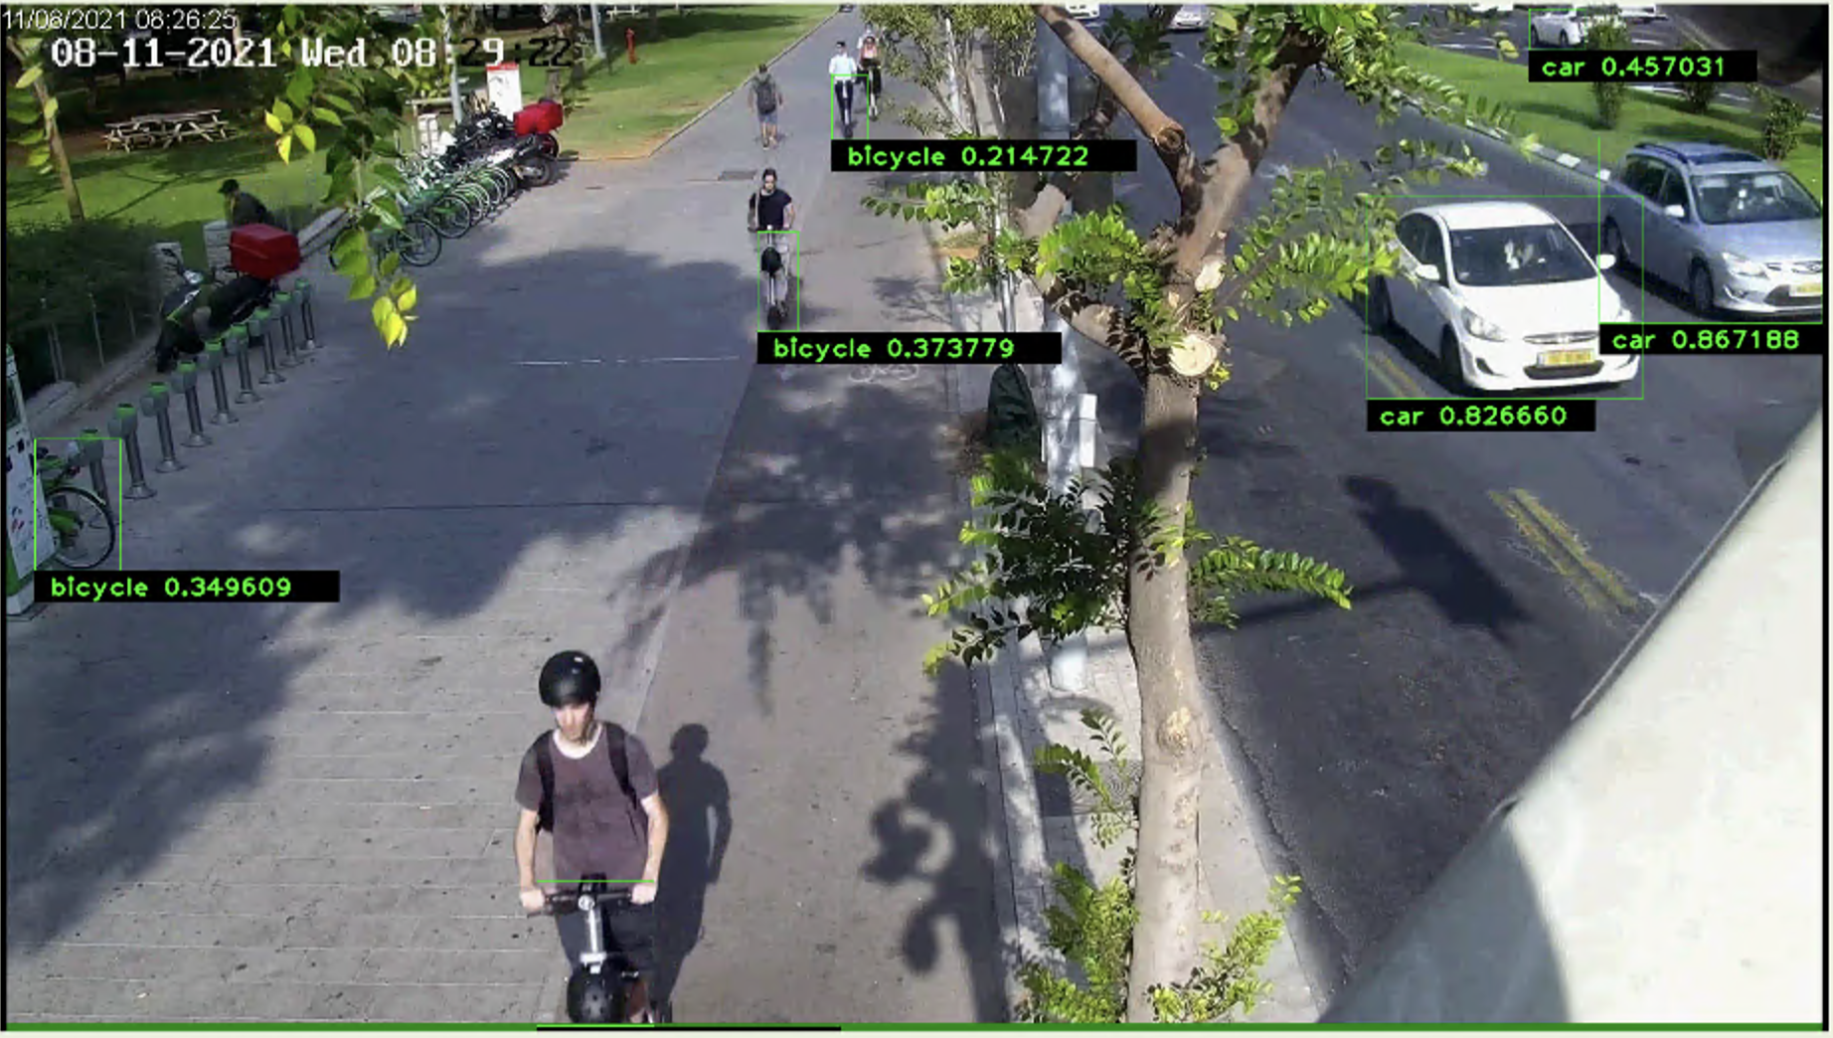
PMD Detection – Front view
Front view of scooter may be detected as bicycle class instead of scooter especially when image is small
- Mosaic augmentation has slightly improved the model, but using a separate classifier within the pipeline is more effective

Slide 4
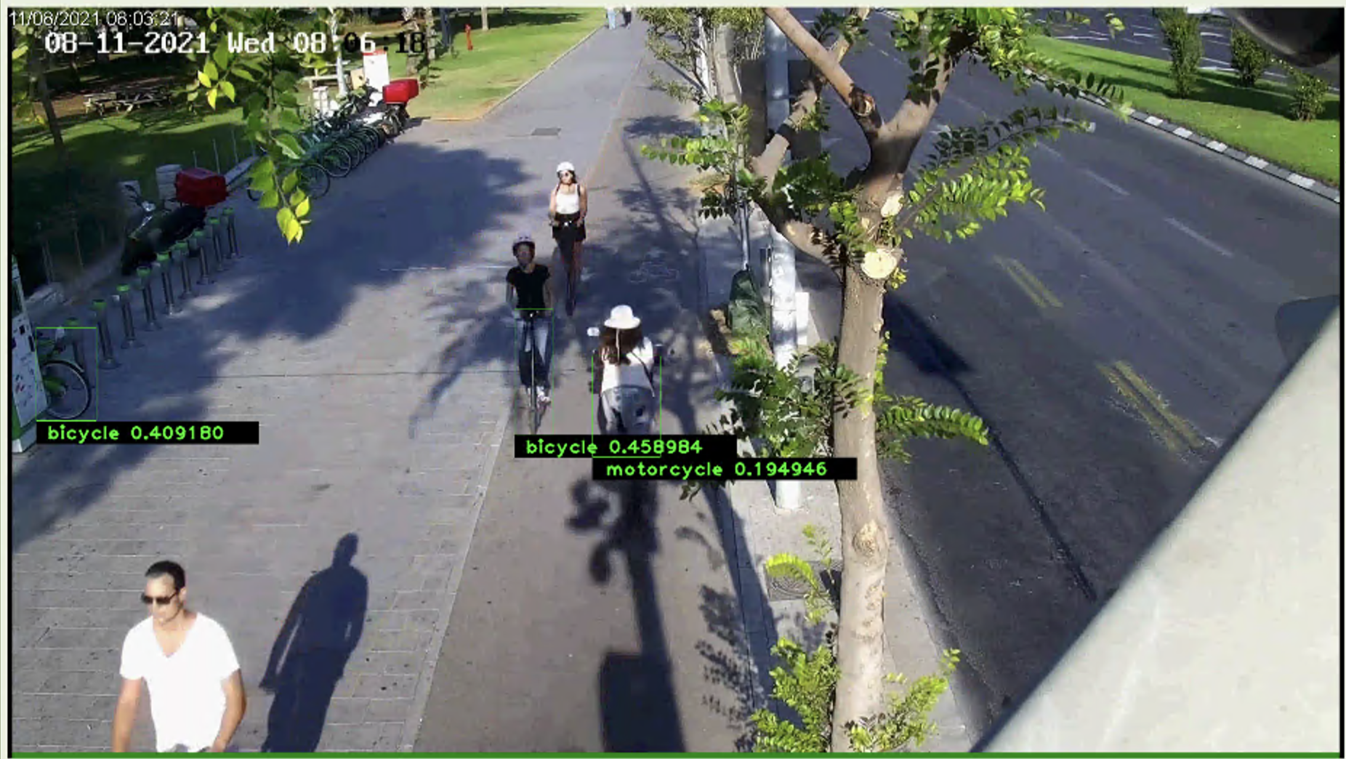
PMD Detection – Front view
- Shadows also tend to affect model performance

Slide 5
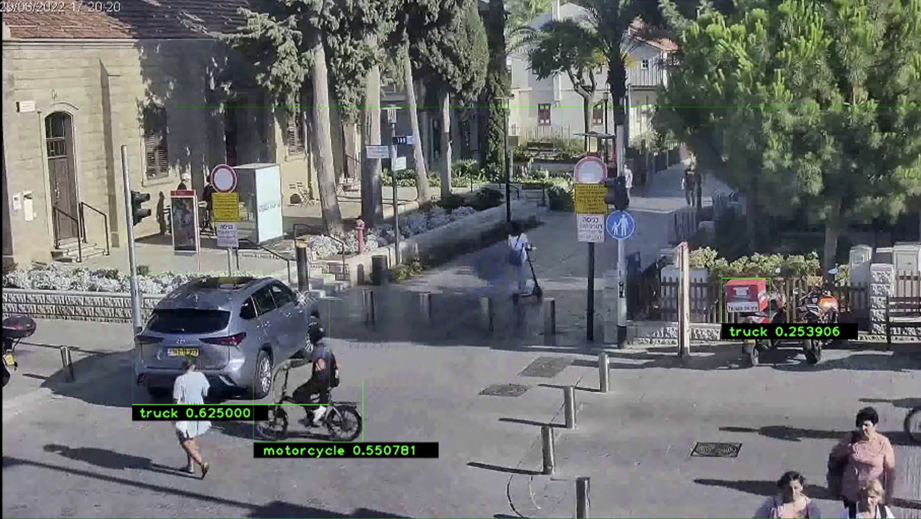

PMD Detection – Side view
- Model also has difficulty detecting sideview of scooter when in shadows / dark areas

Slide 6
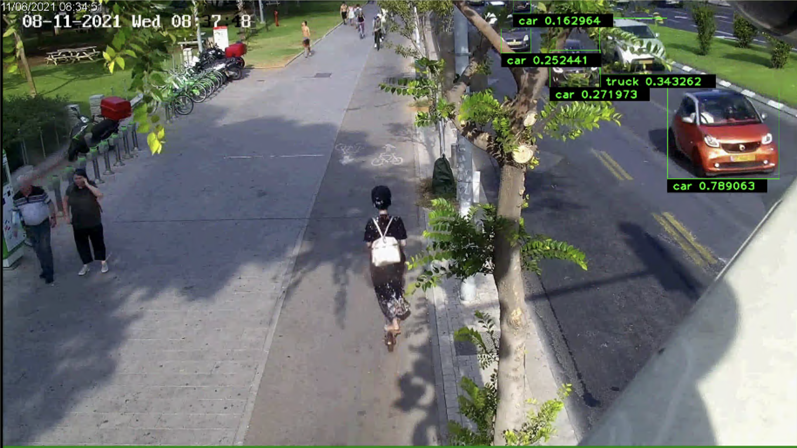
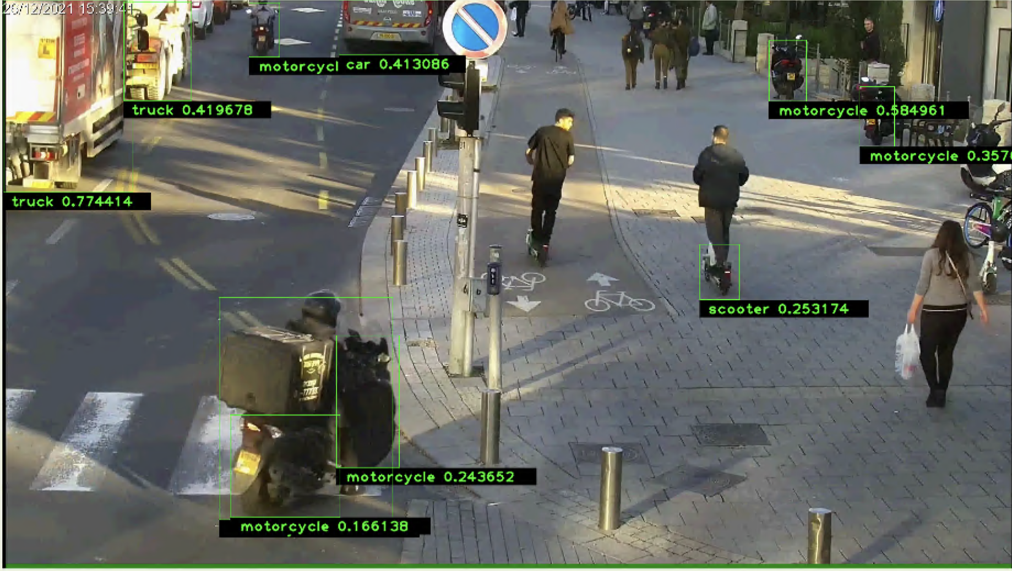
PMD Detection – Back view
- Model inconsistent in detecting scooter rider from the back. Have difficulties detecting when camera angle is directly from the back and far away

Slide 7
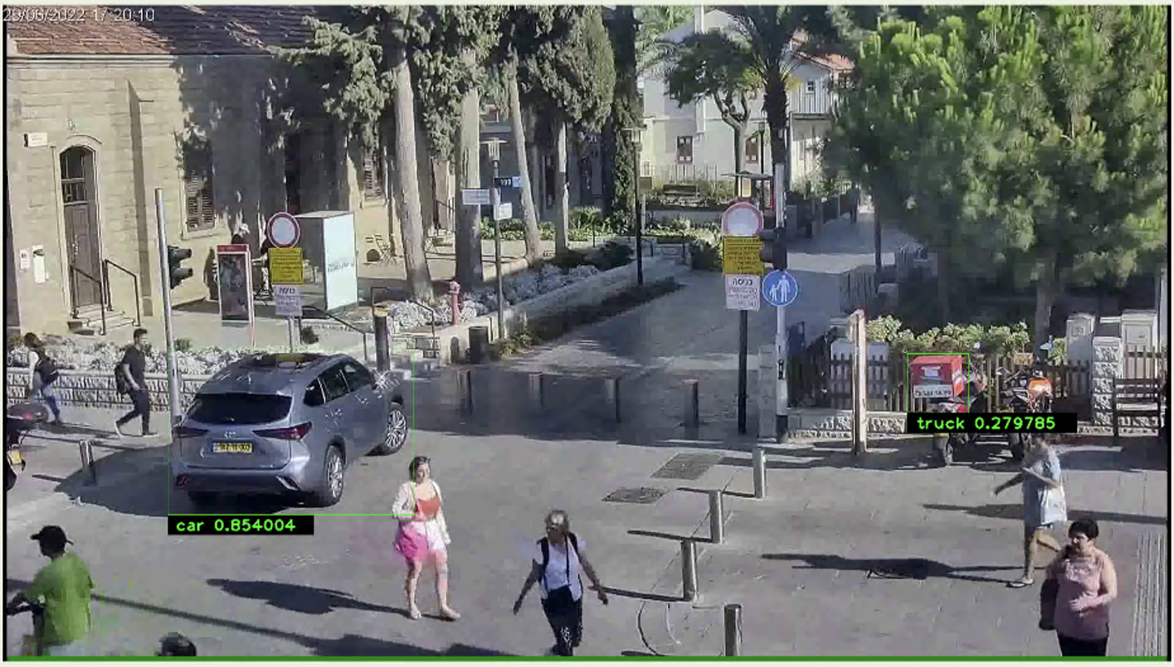
Motorcycle
- Motorcycles with large boxes at the back may be misclassified as a truck

